Slide 1
18-349: Introduction to Embedded Real-Time Systems
Lecture 23: Class Wrap-Up
Anthony Rowe
Electrical and Computer Engineering
Carnegie Mellon University

Slide 2
Administrivia
Lab 4 Due Tonight
Get checked off with demos during office hours
Equipment Turn-in
During Office Hours
Please Return:
Rpi
USB Cable
Rpi Case
SD Card
USB SD Card Reader
Stand-off Kit
Final Exam on Monday December 14th (8:30-11:30) WEH 7500
Open book / note
Will cover everything from lecture up to this point
We will hit some highlights Wednesday
Redemption lab due Midnight on the 14th

Slide 3
Final Logistics
Open book / open note
Bring a calculator!
No electronic communication (laptop and cellphone are not allowed)
Format
Approximately 10 questions
Mix of multiple choice and short answers
Comprehensive, but with a focus on the second half of the course

Slide 4
First Half of Course
L1 – What is embedded?
L2 – ARM Architecture
L3 – ARM ASM
L4 – Memory Mapped I/O
L5 – Serial Buses
L6 – Timers and Interrupts
L7 – SWI
L8 – ADC and DAC
L9 – Transducers
L10 – ARM Optimization and Profiling
L11 – DMA and Processes

Slide 5
Second Half of Course
L13 – Scheduling and Concurrency
L14 – RT Scheduling I
L15 – RT Scheduling II
L16 – Memory Management
L17 – RT Linux
L18 – Multi-Core
L19 – Energy Efficiency
L20 – RT Communication
L21 – Wireless Communication
L22 – Controls and PID

Slide 6
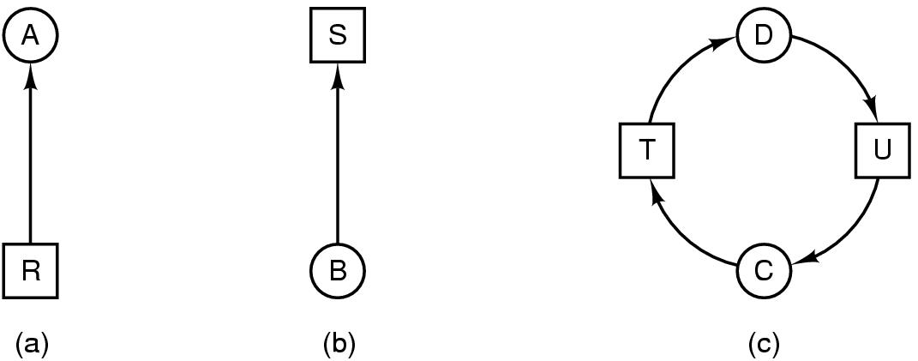
L13: Scheduling and Concurrency
Concurrency Primitives
Semaphore
Mutex
Deadlock
Real-Time vs Non Real-Time
Priority Inversion
P1
P(s1)
...
V(s1)
P2
P(s1)
...
V(s1)
Initial value of s1 = 1
Mutex

Slide 7
L14: Real-Time Scheduling I
Rate Monotonic Scheduling
Upper Bound Test
Response Time Test
Adding Interrupts and Context Swap Blocking terms
Earliest Deadline First
0
5
10
15
20
Task τ₁
Task τ₂
Task τ₃
C₁ C_{n} 1/ n
--- + .... + --- < U(n) = n(2 - 1)
T₁ T_{n}

Slide 8
L15: Real-Time Scheduling II
Priority Inversion
Resource Management
Priority Inheritance Protocol
Priority Ceiling Protocol
Highest Locker Priority (PCP-e)
Non-Preemptible Critical Sections
Attempt to lock S1 (blocked)
τ₁(H)
S1 Locked
Ready
S1 unlocked
τ₂
C
B
Ready
τ₃
S1 Locked
S1 unlocked
τ₄(L)
time

Slide 9
L16: Memory Management
Memory Protection Unit
Virtual Memory
Memory Reservations
Task 3
Task 3
Task 3
Task 2
Task 2
Task 2
Task 1
Task 1
Task 1
CPU chip
TLB
User access
Privileged access
2
VPN
PTE
3
Trans-
lation
Cache/
memory
Processor
1
4
VA
PA
5
Data

Slide 10
L17: Real-Time Linux
Why do we want Linux to exhibit good timing?
Approaches to RT Linux
Limiting RT and Non-RT interactions
Compliant Kernel
Dual Kernel
Integrate RT and Non-RT tasks
Core Kernel Approach
Resource Kernel Approach

Slide 11

L18: Embedded Multicore
Processor₁
Multicore Challenges
Dhall Effect
Global Scheduling
Partitioned Scheduling
Single Shared Ready Queue
Processor₂
Processor₃
…
Processor_{m}
One Ready Queue Per Processor
Processor₁
Processor₂
Processor₃
…
Processor_{m}

Slide 12
L19: Low-Power Embedded
Why do we care about power?
Low-Power Scheduling
Dynamic Voltage and Frequency Scaling
Rate Harmonized Scheduling
Energy-Saving RHS
Timer Coalescing

Slide 13
L20: RT Communication
CAN Bus
Prioritized Messages with Bit Dominance
Almost direct RMS scheduling problem
RT Ethernet
Traffic shaping can yield RT properties
Other options for Prioritization (Transmission delay)

Slide 14
L21: Wireless Communication
Why Wireless?
Wireless Challenges
Hidden Terminal
Exposed Terminal
Near-Far Problem
Low Power Listen
Check Interval
Radio RX
B
Radio TX
Radio RX
A
Radio TX
Sampling Interval

Slide 15
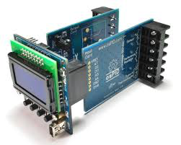
L22: Implementing PID Control
F(e_{t}) = K_{p} (e_{t}) + K_{d} (e_{t} – e_{t-1} ) + K_{i} (e₀ + e₁ + … + e_{t-1})
Proportional K_{p} (e_{t})
Integral K_{i} (e₀ + e₁ + … + e_{t-1})
Derivative K_{d} (e_{t} – e_{t-1} )
r_{t}
e_{t}
u_{t}
v_{t+1}
u_{t} = F(r_{t})
Plant Model
Controller
v_{t}
Plant
Sensor

Slide 16
Topics Covered
What are embedded systems?
ARM architecture
System Calls (SWIs)
Program Loading/Linking
Code Optimization
Serial Communications
Interrupts, Exceptions
Memory-Mapped I/O
ARM Assembly Language
Combining Assembly and C
Basic Concurrency
Processes and CPU Scheduling
Mutual Exclusion, Deadlock
Semaphores
Real-Time Resource Management
Scheduling algorithms
Task Synchronization
UB test & RT test
Priority Inversion
Memory Management, MPU, MMU
RT Communication
Multicore
Energy
Wireless
Controls
We covered a wide spectrum.

Slide 17

And Finally…
Best news yet, the course is almost over!

Slide 18
18-648 Preview
Dive Deep into Linux Kernel Hacking
Pickup from Lab 4
Make Linux an RTOS
Nexus Tablet Hacking
Lots of coding
Learn to PROVE why RMS works
Take on the multi-core challenge
Look at different real-time algorithms for global and partitioned scheduling
Learn about how to manage DVFS with RT constraints

Slide 19
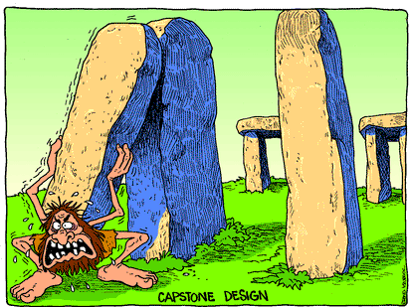
18-549 Preview
Course Organization
Few Labs (one to teach you PCB design)
NO mid-term exam
NO final exam
Assignments: Design reviews and project reports
Project – team-based and focus of the course
Think of a field-demo scenario that you will be able to show me
What would you put into a five-minute video clip to pitch your solution?
Even better if you can think of a “Before” and “After” scenario
How do people do things without your solution now?
Important to have done a competitive analysis
What’s out there that competes with your solution?
Why is your solution any better or different?
Talk to me NOW!

Slide 20
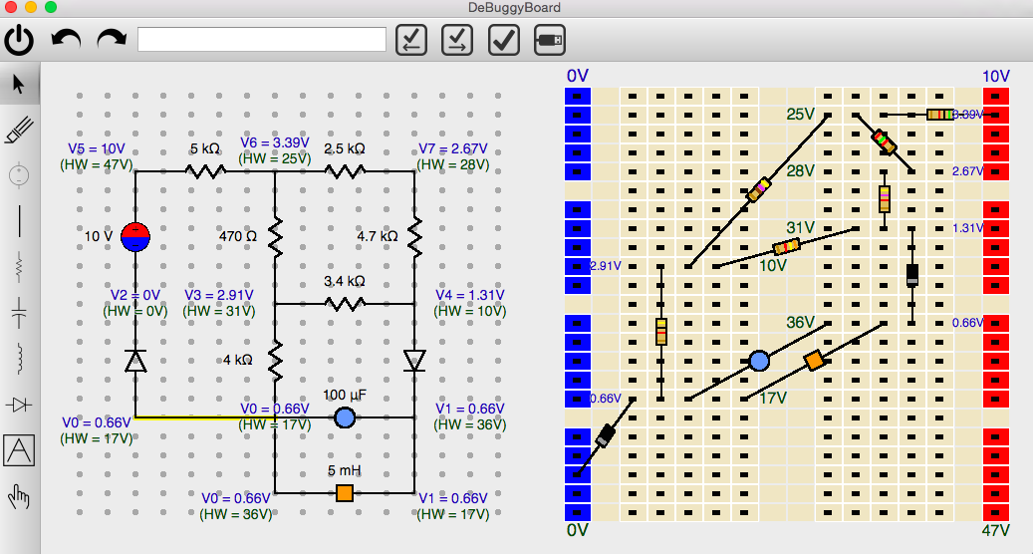
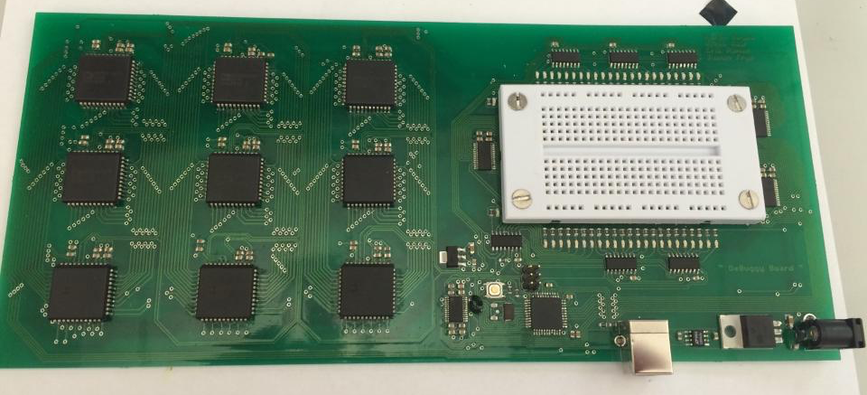
(DE) Buggy Board
https://www.ece.cmu.edu/~ece549/spring15/team01/website/

Slide 21
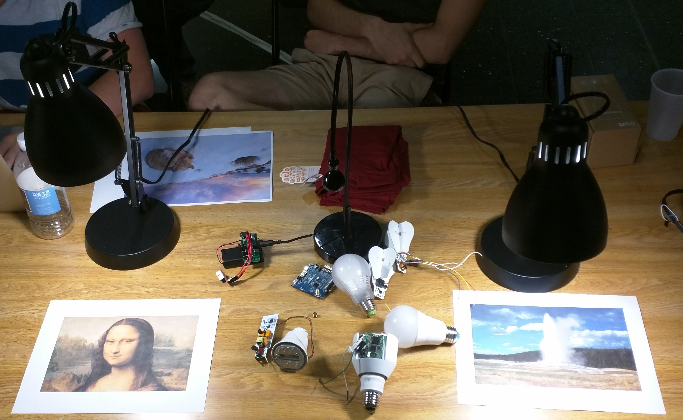
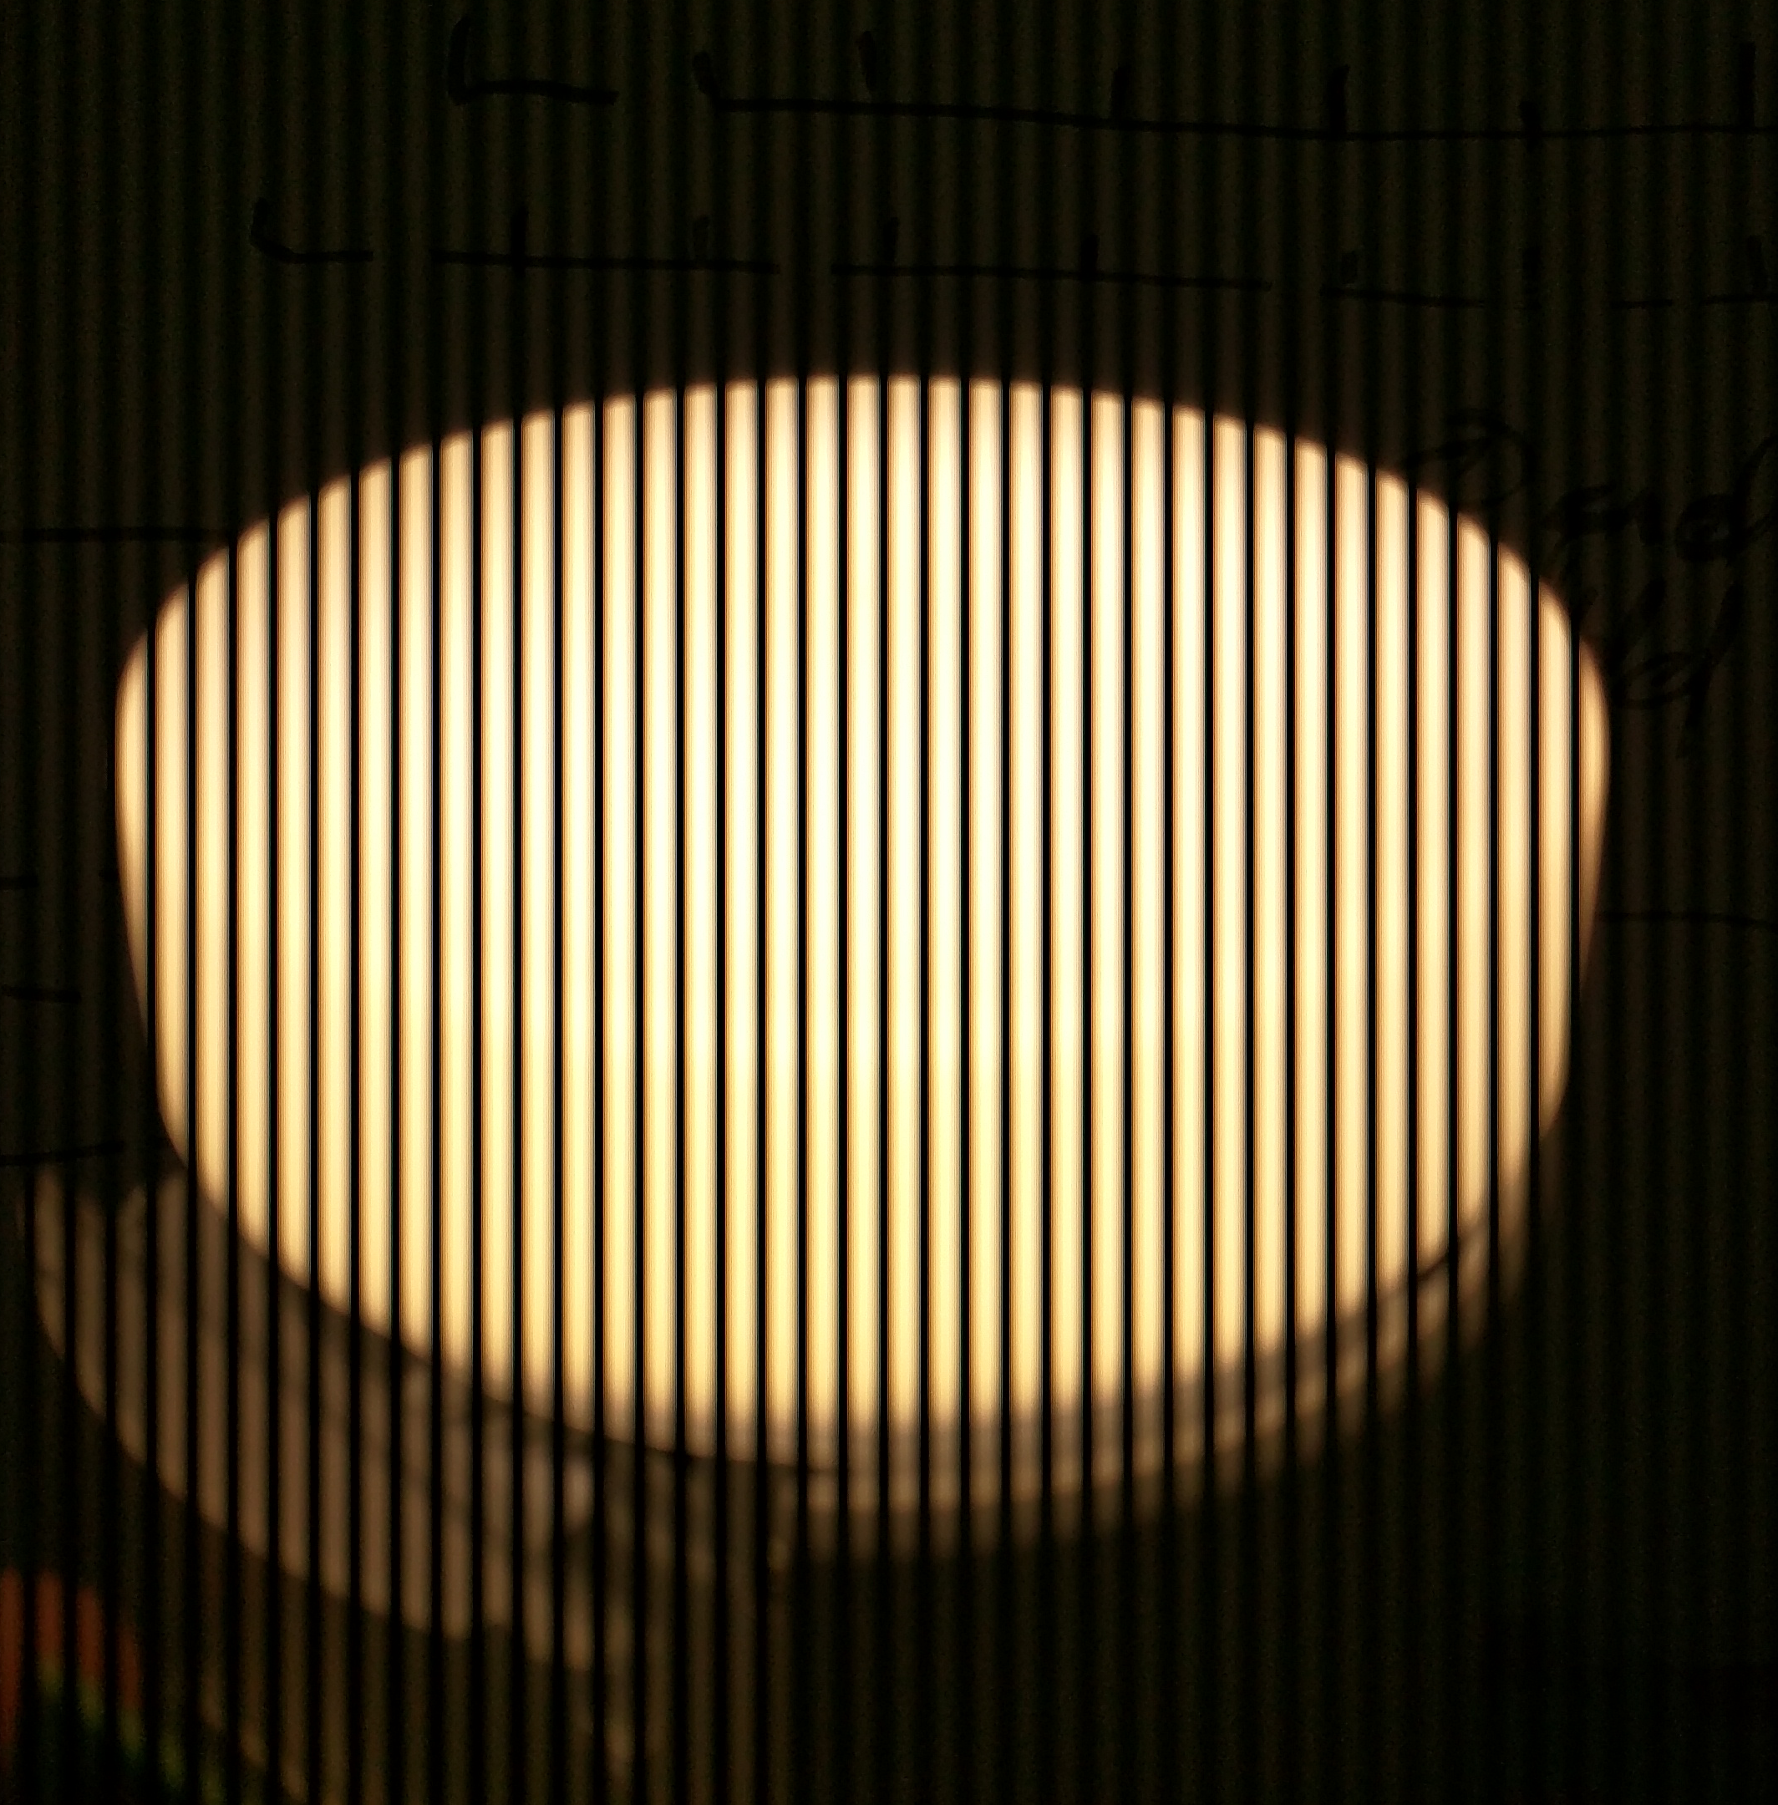
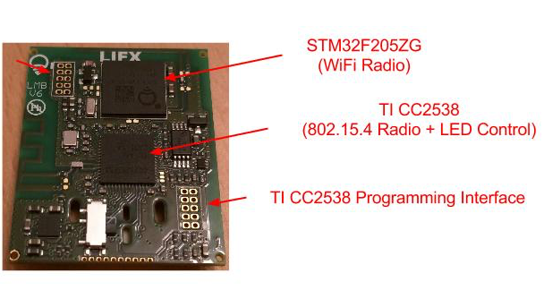
Enlighten
https://www.ece.cmu.edu/~ece549/spring15/team10/website/

Slide 22
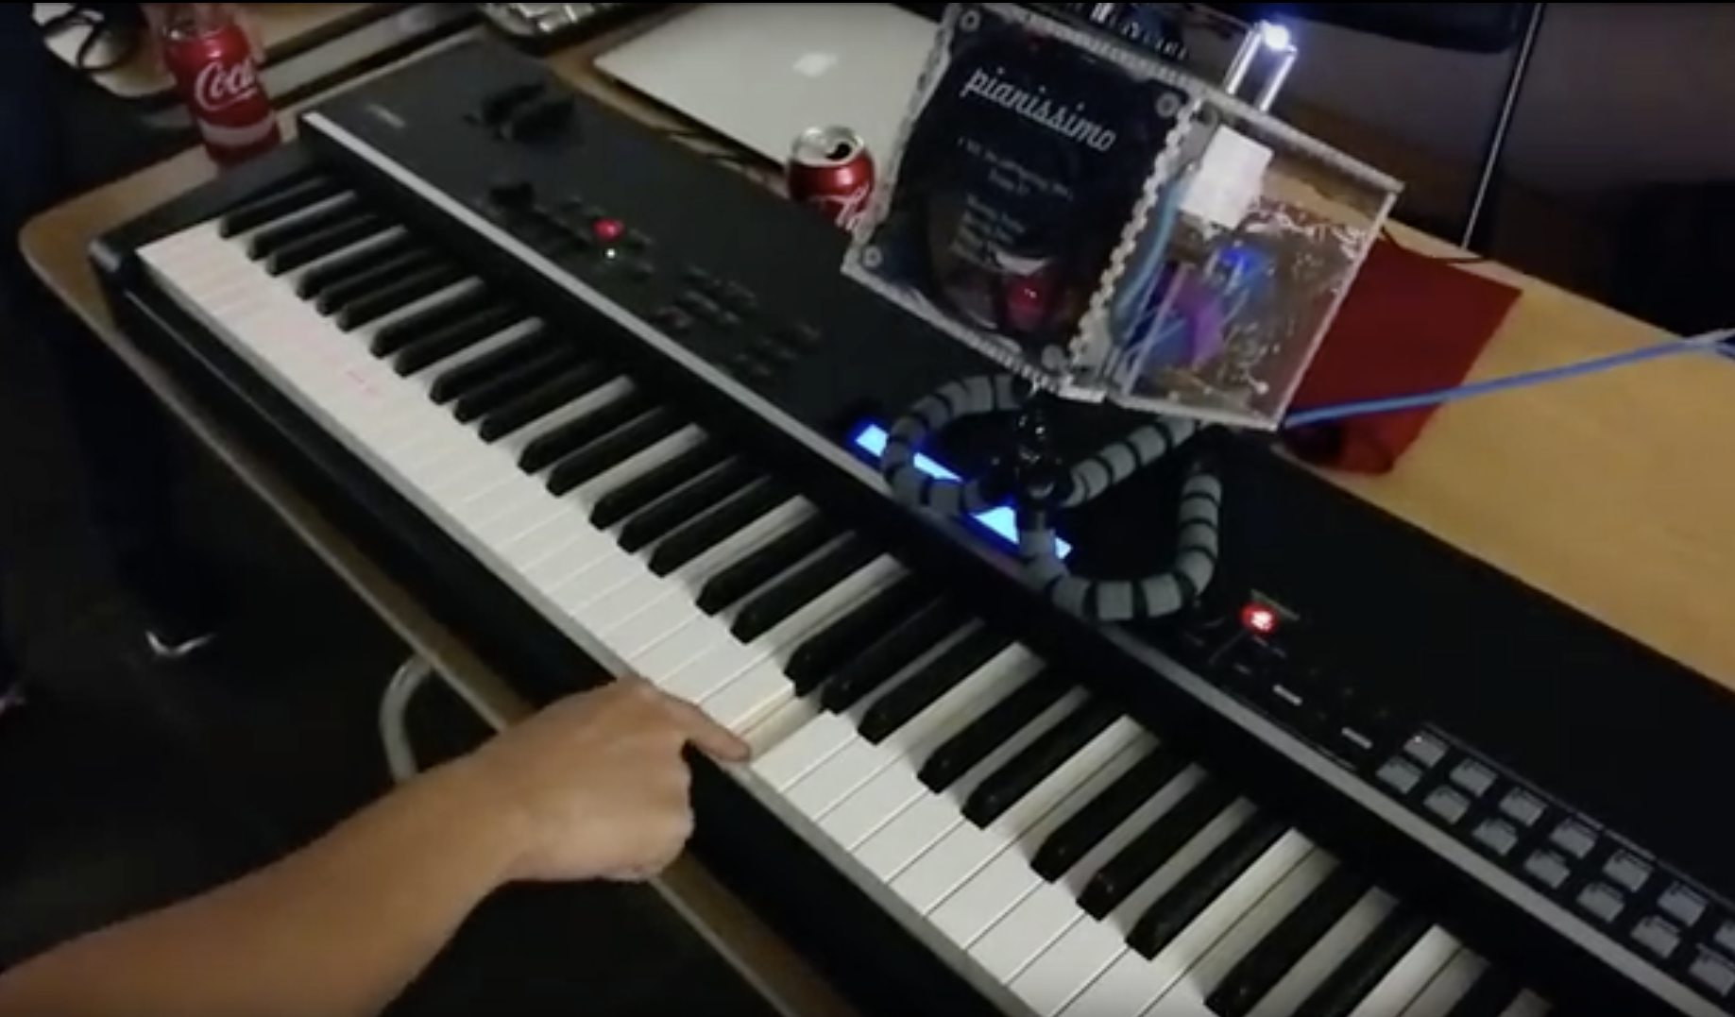
Pianissimo
https://www.ece.cmu.edu/~ece549/spring15/team12/website/

Slide 23
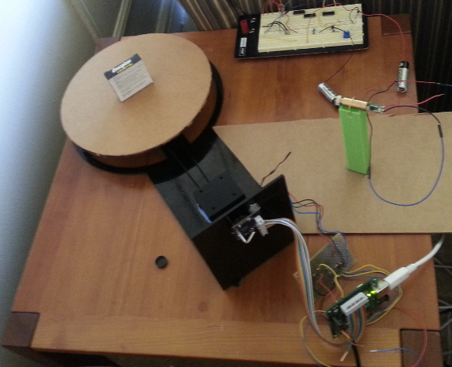
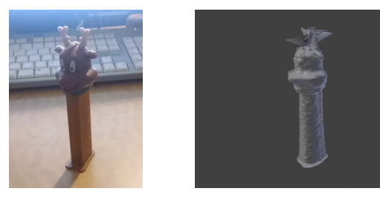
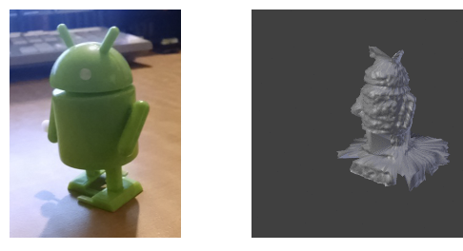
Scanner Dude
https://www.ece.cmu.edu/~ece549/spring15/team19/website/progress.html

Slide 24





















Embedded Systems Careers

Slide 25
Doing Research
Can undergrads get involved in research projects?
ABSOLUTELY
Why should I do research?
I’m thinking of graduate school, but I don’t know
I’m thinking of graduate school FOR SURE
I think classes are BS and want to get my hands dirty with something real
How do I get involved?
Reach out to faculty in the space (a couple of times)
Talk to graduate students in various groups and ask them about what they are doing…
The best time is right after finals…
Second best time is the start of the next semester
You can usually get credit or even pay depending on the project

Slide 26
Wednesday’s Class
Final Exam Review
We will highlight high points to study
Problems
We will walk through some example problems

Slide 27
Thanks! Good Luck on the Final

